Slide 1
Booth’s Multiplication Algorithms

Slide 2
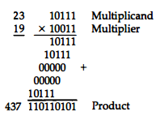
Multiplication of two binary numbers is done by a process of successive shift and add operations

Slide 3
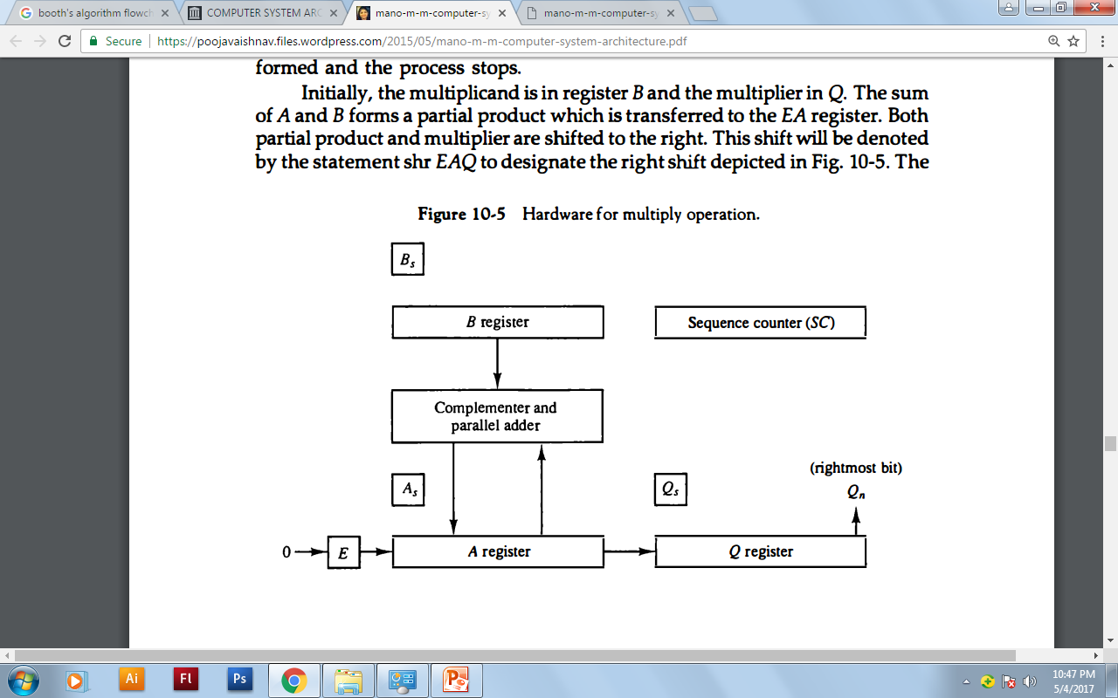

Slide 4
The multiplier is stored in the Q register and its sign in Qs.
The sequence counter SC is initially set to a number equal to the number of bits in the multiplier.
The sequence counter is decremented by 1 after forming each partial product. When the content of the counter reaches zero, the product is formed and the process stops.

Slide 5
Booth’s Algorithm for Multiplication
Initially, the multiplicand is in B register and the multiplier in Q register. Their corresponding signs are in Bs, and Qs, respectively.

Slide 6
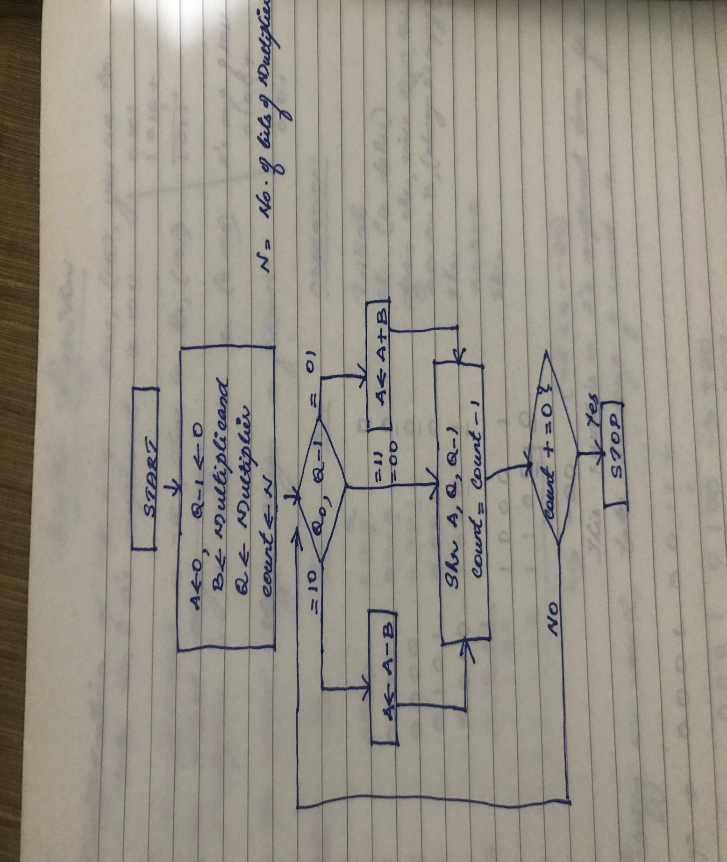

Slide 7
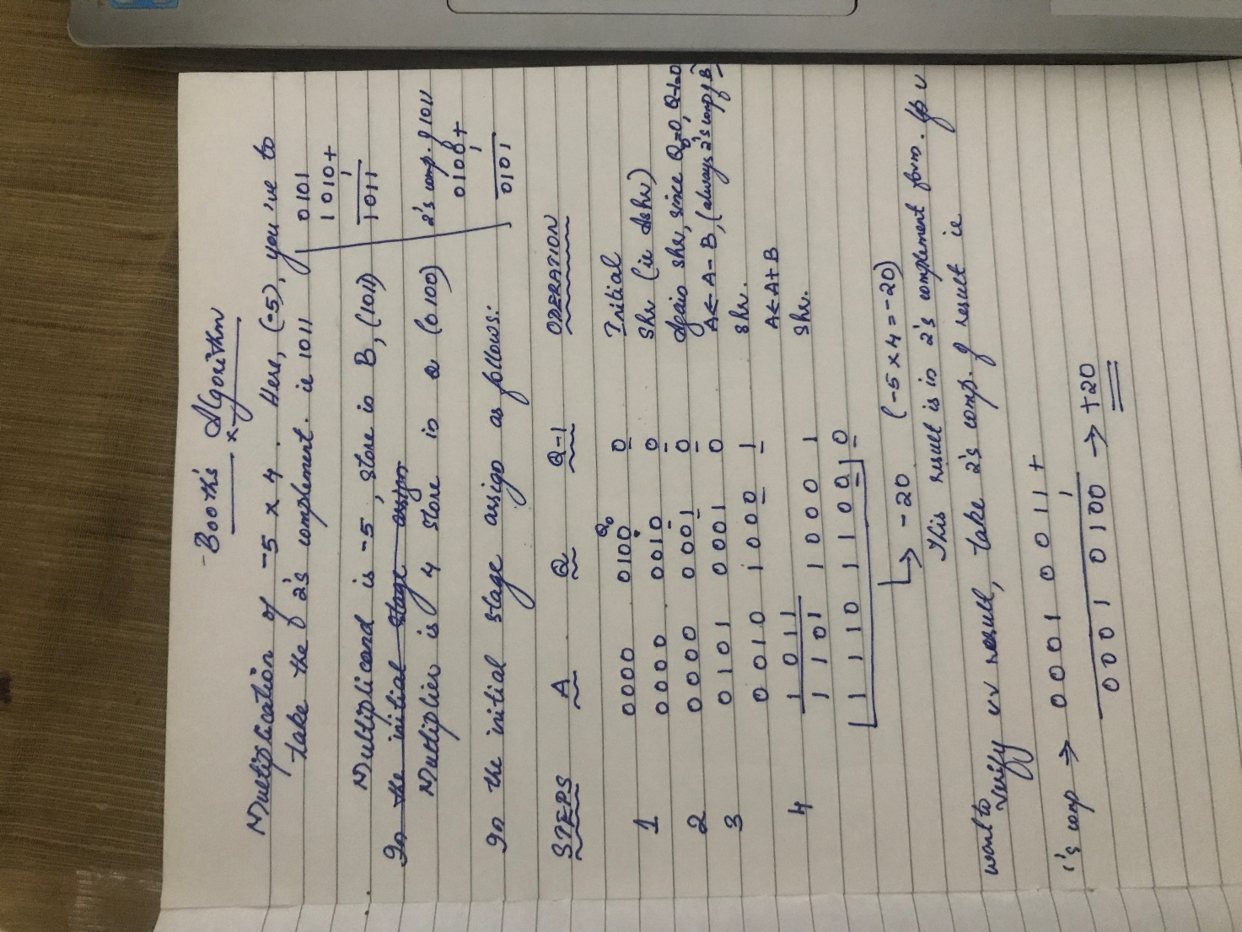

Slide 8
END

